Slide 1


Team World Wide
Big Data Hackathon

Slide 2
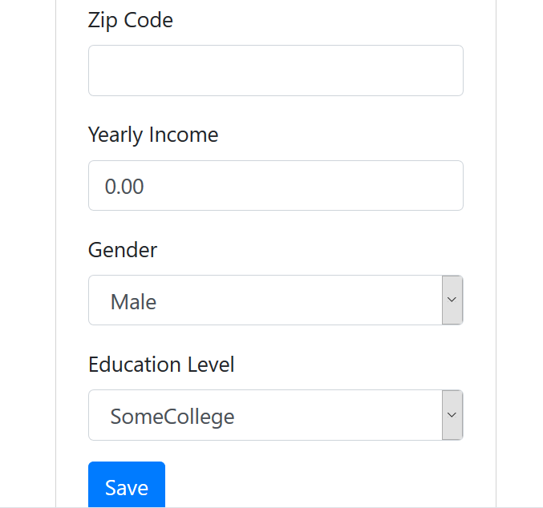
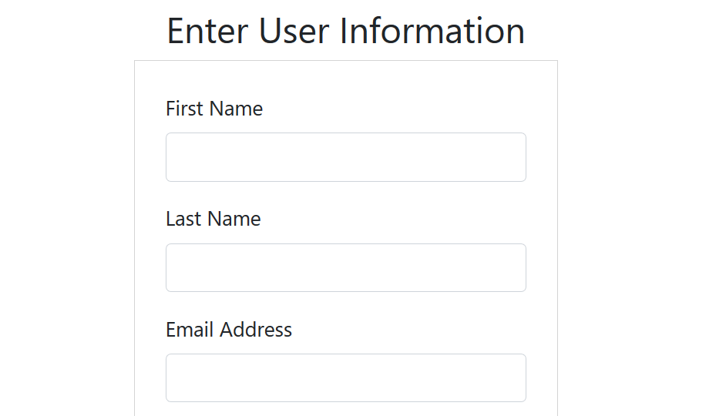
Idea behind Web Application

Slide 3
Idea behind Web Application
This web application was supposed to allow users to enter their personal data and then have relevant transportation and money estimates pulled.
The goal was to combine personal commute data with information from various datasets and perhaps even google maps to show estimated costs to the user.
Some of the estimated costs
* estimate time stuck in traffic
* estimate mileage costs
* health costs
* carbon footprint

Slide 4
Stats
The data was from around Downtown San Diego area.
We used the transaction time and transaction amount (in cents) to check how long people are typically staying for based on time of day.
We hoped that we could change the parking meter’s max time or price to increase flow.

Slide 5
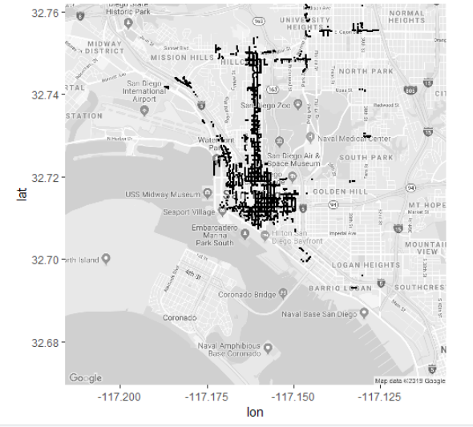
Stats

